Slide 1
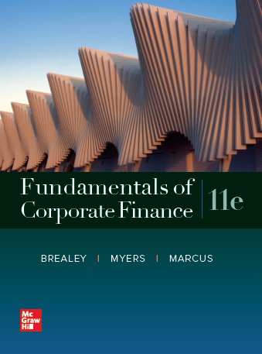
Fundamentals of Corporate Finance, 11th Edition
CHAPTER 5: The Time Value Of Money
© McGraw Hill LLC. All rights reserved. No reproduction or distribution without the prior written consent of McGraw Hill LLC.

Slide 2
Perpetuities and Annuities
Perpetuity
A stream of level cash payments that never ends
Difficult: an infinite stream of payments that nevertheless has a finite value
Notes:
44

Slide 3

Perpetuities and Annuities
PV of Perpetuity Formula
$$\text{PV}\text{ =} \frac{\text{PMT}}{\text{r}}$$
PMT = cash payment
r = interest rate
Notes:
45

Slide 4
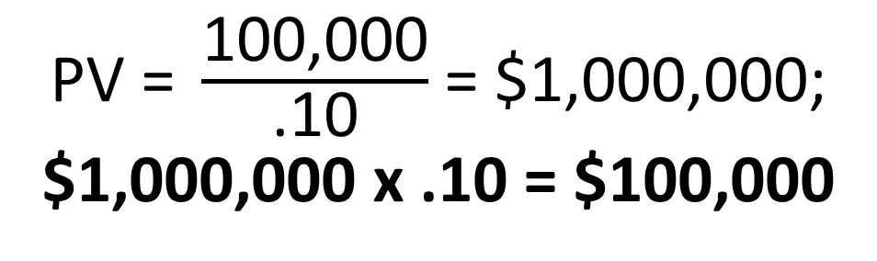
Perpetuities and Annuities
Example
In order to create an endowment, which pays $100,000 per year forever, how much money must be set aside today in the rate of interest is 10%?
$\text{PV}\text{ = }\frac{\text{100,000}}{\text{.10}}$ $\text{=}\text{ \$1,000,000}$;
$1,000,000 x .10 = $100,000
Notes:
47

Slide 5
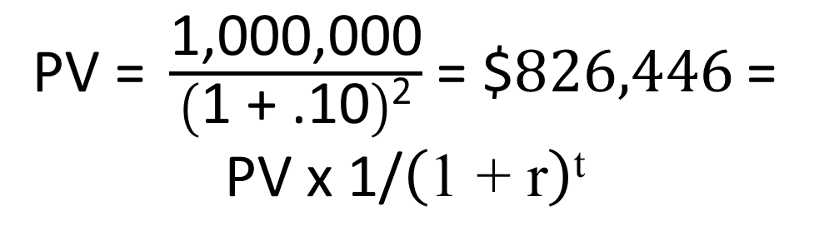
Perpetuities and Annuities
Example (continued)
If the first perpetuity payment will not be received until three years from today, how much money needs to be set a side today? (see timeline) Excel
$\text{PV}\text{ = }\frac{\text{1,000,000}}{\left(\text{1 + .10}\right)\text{2}}$ $\text{=}\text{ \$}826,446$= PV x 1/$\left(\text{1 + }\text{r}\right)\text{t}$
Notes:
49

Slide 6
See textbook section 5.5
Timelines for two perpetuities:
Perp A $1 $1 $1 $1 $1 $1 ….. PV= $1/r
Perp B $1 $1 $1 …..PV =$1/r(1 + r)^{t}
What is PV Perp A – PV Perp B? The PV of a 3-year annuity Excel
So, PV annuity formula is
1/r – 1/r(1+r)^{t}

Slide 7
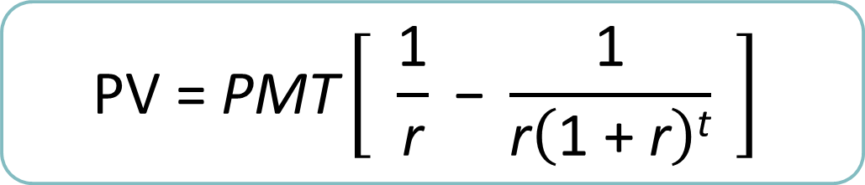
Perpetuities and Annuities
PV of Annuity Formula
$$\text{PV}\text{ = }\text{PMT}\left[ \frac{\text{1}}{\text{r}}\text{ − }\frac{\text{1}}{\text{r}\left(\text{1 + }\text{r}\right)\text{t}} \right]$$
PMT = cash payment
r = interest rate
t = Number of years cash payment is received
Notes:
50

Slide 8
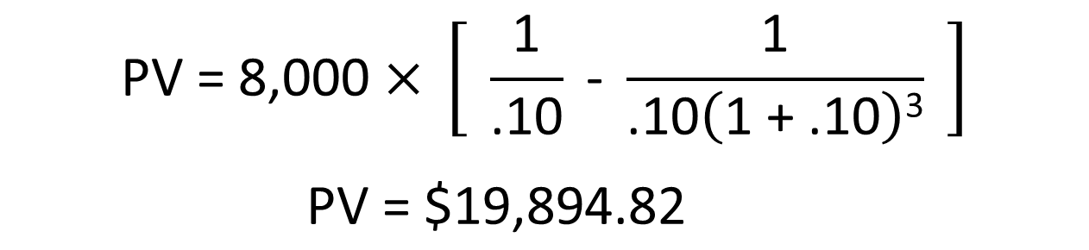
Perpetuities and Annuities
Example
You are purchasing a car. You are scheduled to make 3 annual installments of $8,000 per year. Given a rate of interest of 10%, what is the price you are paying for the car (i.e., what is the PV)?
$$\text{PV}\text{ = 8,000 }\text{×} \left[ \frac{\text{1}}{\text{.10}}\text{ − }\frac{\text{1}}{\text{.10}\left(\text{1 + .10}\right)\text{3}} \right]$$
$$\text{PV} \text{=} \text{\$19,894.82}$$
Notes:
53

Slide 9
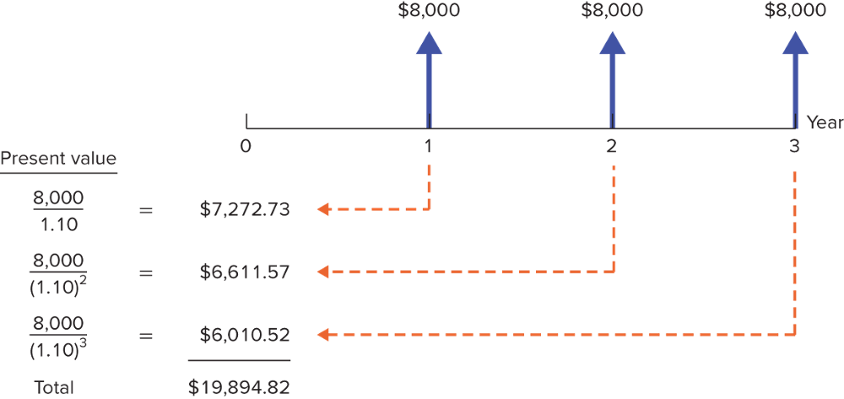
Perpetuities and Annuities
Example (continued)
You are purchasing a car. You are scheduled to make 3 annual installments of $8,000 per year. Given a rate of interest of 10%, what is the price you are paying for the car (i.e. what is the PV)?
Notes:
53

Slide 10
Perpetuities and Annuities
Applications
Value of payments (for a Bond investment)
Implied interest rate for an annuity
Calculation of periodic payments
Mortgage payment
Annual income from an investment payout
Future Value of annual payments
Excel
Notes:
54

Slide 11
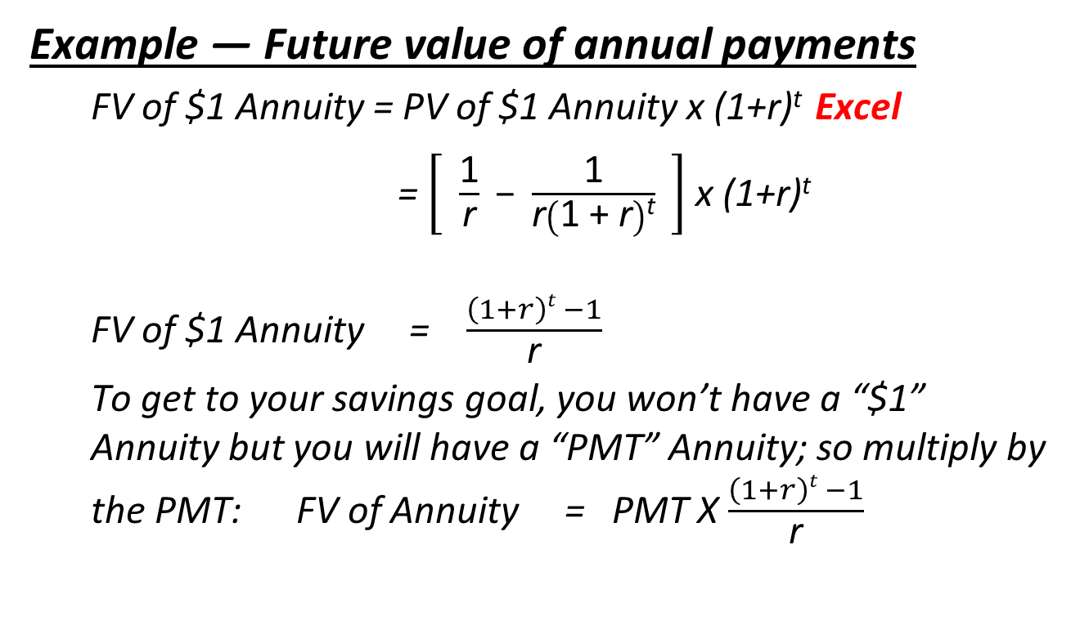
Perpetuities and Annuities
Example — Future value of annual payments
FV of $1 Annuity = PV of $1 Annuity x (1+r)^{t} Excel
= $\left[ \frac{\text{1}}{\text{r}}\text{ − }\frac{\text{1}}{\text{r}\left(\text{1 + }\text{r}\right)\text{t}} \right]$ x (1+r)^{t}
FV of $1 Annuity = $\frac{\left(1+r\right)t −1}{\text{r}}$
To get to your savings goal, you won’t have a “$1” Annuity but you will have a “PMT” Annuity; so multiply by the PMT: FV of Annuity = PMT X $\frac{\left(1+r\right)t −1}{\text{r}}$
Notes:
56

Slide 12
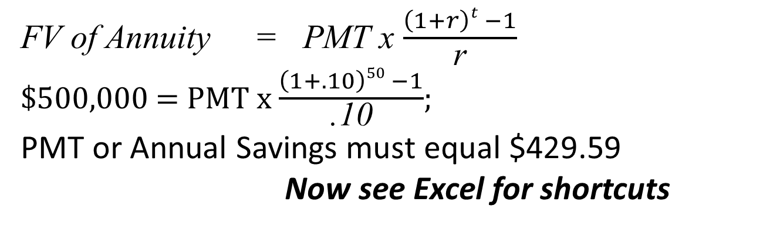
Perpetuities and Annuities
Example — Future value of annual payments
You plan to save for 50 years and then retire. Given a 10% rate of interest, if you desire to have $500,000 at retirement, how much must you save each year?
FV of Annuity = PMT x $\frac{\left(1+r\right)t −1}{\text{r}}$
$500,000 = PMT x $\frac{\left(1+.10\right)50 −1}{\text{.10}}$;
PMT or Annual Savings $\text{must} \text{equal}\text{ \$429.59}$
Now see Excel for shortcuts
Notes:
56

Slide 13
Annuities Due
Annuity Due (See Lecture 3 discussion)
Level stream of cash flows starting immediately
How does it differ from an ordinary annuity?
One year more (one extra r)→ (1+r)
$$\text{PV}\text{Annuity} \text{Due}\text{ = }\text{PV}\text{Annuity} \text{×} \left(\text{1 + }\text{r}\right)$$
How does the future value differ from an ordinary annuity?
$$\text{FV}\text{Annuity} \text{Due} \text{=} \text{FV}\text{Annuity} \text{×} \left(\text{1} \text{+} \text{r}\right)$$
Notes:
44
Annuity Due: Level stream of cash flows starting immediately.

Slide 14

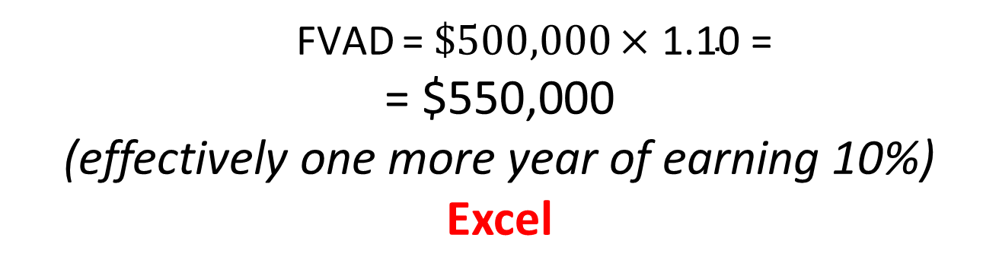
Annuities Due
Example
Suppose you invest $429.59 annually at the beginning of each year at 10% interest. After 50 years, how much would your investment be worth?
$$\text{FV}\text{AD}\text{ = }\text{FV}\text{Annuity} \text{×} \left(\text{1 + }\text{r}\right)$$
$\text{FVAD} \text{= }\$500,000 \text{×}\text{ 1.10 }$=
$$\text{=}\text{ \$550,000}$$
(effectively one more year of earning 10%) Excel
Notes:
54
Annuity Due: Level stream of cash flows starting immediately.

